Slide 1
5.2 Control System Engineering (CSE)
By: Zain Rajani
Don Bosco College of Engineering, Fatorda, Goa

Slide 2
SCHEME OF INSTRUCTION
Control System Engineering , Don Bosco College of Engineering

Slide 3
Course Contents:
Module I:
Types of Control Systems (Close loop and Open loop)
Mathematical Modelling (mechanical and electrical system)
Force-Voltage and Force-Current Analogy
Block Diagram Representation
Signal Flow Graphs and Transfer Functions
Module II
Transient Response of first and second order system
Type 0, 1 , 2 Control system
Steady state, Stability Control
Routh-Hurwitz Criteria
Root-locus techniques, Robust Control
Control System Engineering , Don Bosco College of Engineering

Slide 4
Course Contents:
Module III:
Frequency Domain Analysis
Types of Plots
Polar Plots
Bode Plots
Nyquist Plot
Stability using Nyquist Plot
Module IV:
Compensator and their types
Design of Cascade Compensator in Frequency and Time Domain (Lead, Lag and Lead-Lag Compensator)
Digital Control System (Sampling, discrete time system)
Control System Engineering , Don Bosco College of Engineering

Slide 5
Books to be referred:
Control Systems, -A.Nagoor Kani, RBA Publications, Chennai
Control Systems Engineering,– I.J. Nagrath and M. Gopal, The New Age International (P) Ltd., New Delhi
Control System Engineering , Don Bosco College of Engineering

Slide 6
So Let’s Enter in the world of Control System Engineering
Control System Engineering , Don Bosco College of Engineering
Notes:
<number>

Slide 7
What do you think is control system?
Control System Engineering , Don Bosco College of Engineering

Slide 8
Basic Definitions
System: A system is a combination of different physical components which act together as an entire unit to achieve certain objective
Ex. A classroom is a good example of a physical system. A room along with the combination of benches, blackboard, fans, lighting arrangement etc. can be called as classroom which acts as elementary system
Control System: To control means to regulate, to direct or to command. Hence a control system is an arrangement of different physical elements connected in such a manner so as to regulate, direct or command itself or some other system.
Ex. If in a classroom, a professor is delivering her lecture the combination becomes control system as he tries to regulate, direct or command the students in order to achieve a objective which is to impart good knowledge to the students
Ex. A child plays with kite he tries to control it with help of string the entire system is called as control system
Control System Engineering , Don Bosco College of Engineering

Slide 9
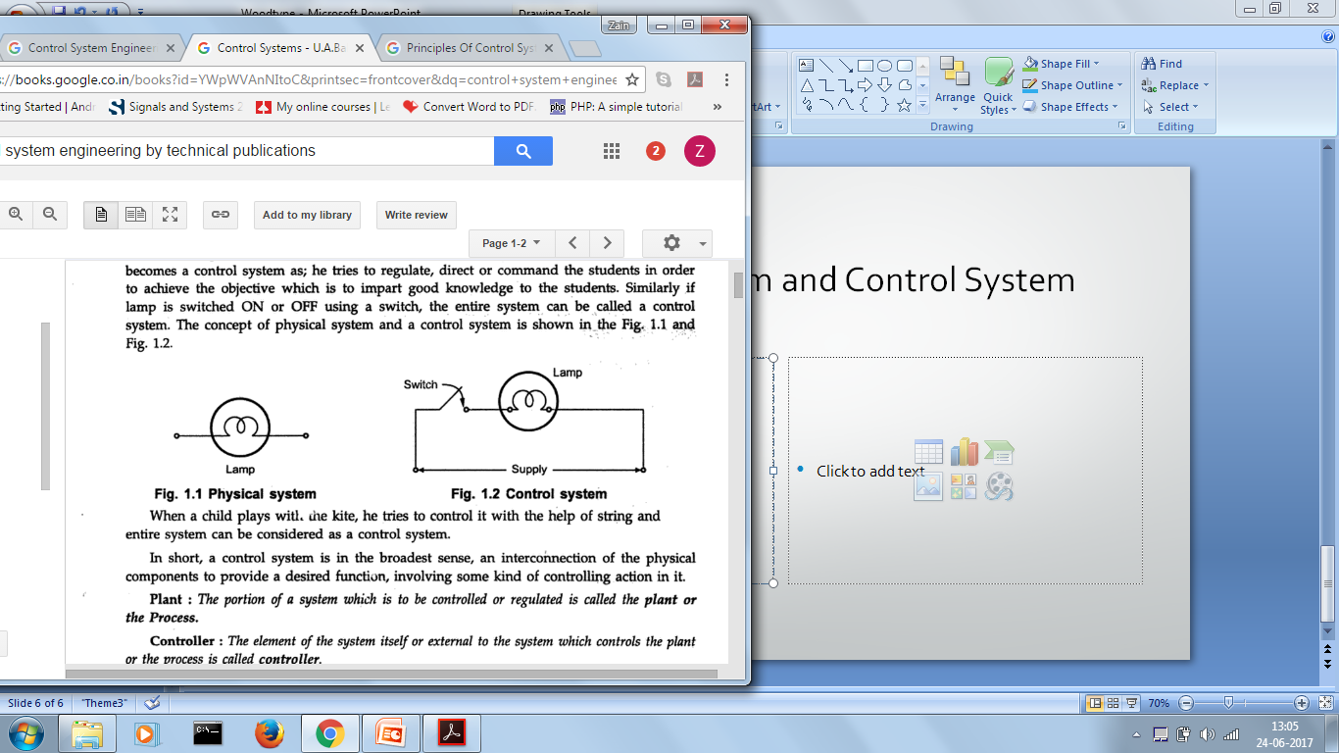
Example of System and Control System
Control System Engineering , Don Bosco College of Engineering

Slide 10
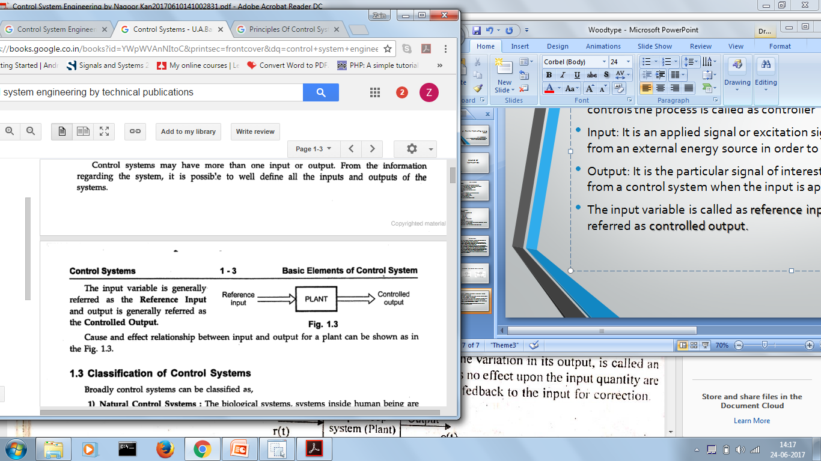
Process: The portion of a system that is to be controlled or regulated is called the plant or process
Controller: The element of the system itself or external to the system which controls the process is called as controller
Input: It is an applied signal or excitation signal applied to a control system from an external energy source in order to produce a specified output
Output: It is the particular signal of interest or the actual response obtained from a control system when the input is applied.
The input variable is called as reference input and output is generally referred as controlled output.
Control System Engineering , Don Bosco College of Engineering

Slide 11
Classification of Control Systems
Natural Control System
Manmade Control System
Combination Control System
Time Varying and Time Invariant System
Linear and Non-Linear System
Continuous Time and Discrete Time Control System
Deterministic and Stochastic Control System
Lumped and Distributed Parameter Control syste
Single Input Single Output (SISO) and Multiple Input Multiple Output (MIMO)
Open and Close Loop System
Control System Engineering , Don Bosco College of Engineering

Slide 12
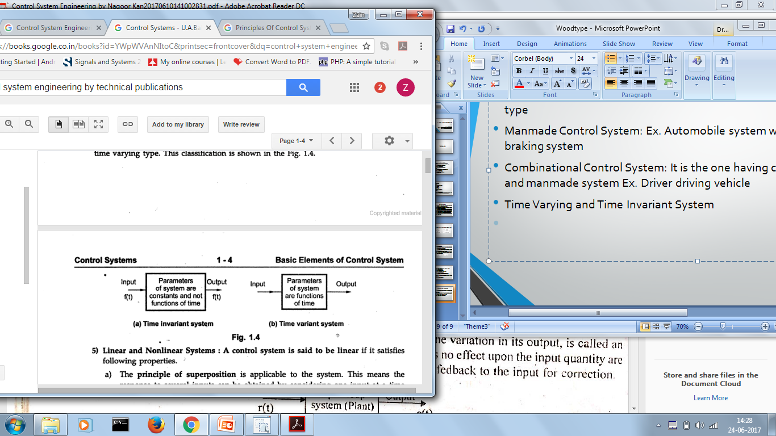
Types of Control System
Natural Control System: Biological system inside human being are natural type
Manmade Control System: Ex. Automobile system with gears, accelerators, braking system
Combinational Control System: It is the one having combination of natural and manmade system Ex. Driver driving vehicle
Time Varying and Time Invariant System
Control System Engineering , Don Bosco College of Engineering

Slide 13
Types of Control System
Deterministic and Stochastic Control System: A control system is said to be deterministic when its response to input as well as behaviour to external disturbances is predictable and repeatable. If such response is unpredictable system is said to be stochastic in nature.
Lumped and Distributed Control System: Control System described by the ordinary differential equation is called as lumped control system and that described by partial differential equations is called as distributed control system.
Control System Engineering , Don Bosco College of Engineering

Slide 14
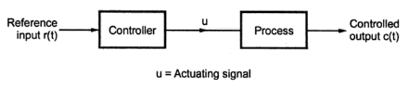
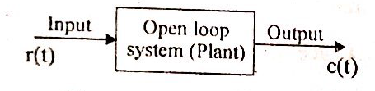
Open Loop System
A system in which output is dependent on input but controlling action or input is independent of the output of the system is called as Open Loop System
Output can be varied by varying input. Due to disturbances it is not followed by changes in input to correct the output.
Control System Engineering , Don Bosco College of Engineering

Slide 15
Open Loop System
Advantages:
Disadvantages:
Accuracy of such system are totally dependent on the accurate precalibration of the controller
Such system gives inaccurate results if variation in external environment
Cannot sense internal noise/ disturbances
Recalibration of controller required from time to time
Simple in construction
Convenient when output is difficult to measure
Easy for maintenance
No stability problems
Easy for design and economical
Control System Engineering , Don Bosco College of Engineering

Slide 16
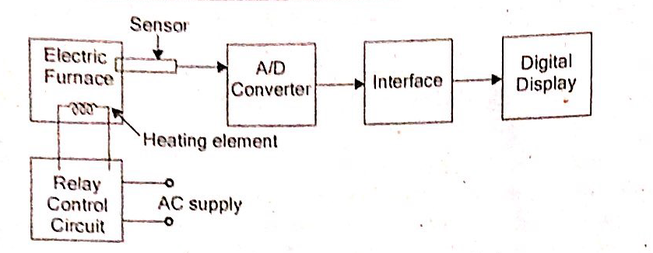
Example of Open Loop Control System
Ex 1. Temperature Control System:
The output of the system is desired temperature. The temperature of the system is raised by heat generated by the heating element. The ON and OFF is governed by setting relay. The output is analog voltage corresponding to the furnace which is converted in to digital. In this system if there is any change output temperature then the time setting of the relay is not altered automatically.
Control System Engineering , Don Bosco College of Engineering

Slide 17
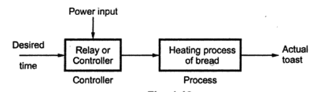
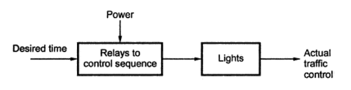
Other Examples of Open Loop System
Ex 2. Sprinkler used to water a lawn:
The system is adjusted to water a given area by opening water valve and observing the resulting pattern
Ex 3. Automatic Toaster System:
Ex 4: Traffic Light Control:
Control System Engineering , Don Bosco College of Engineering

Slide 18
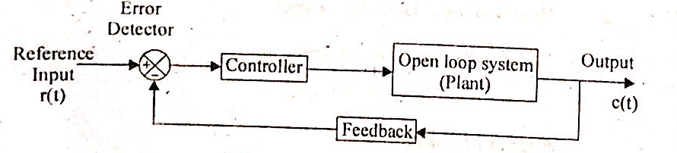
Closed Loop System
A system in which the controlling action or input is somehow dependent on output or changes in output is called closed loop system
It uses the feedback system
Feedback is a property of the system by which it permits the output to be compared with the reference input to generate the error signal based on which the appropriate controlling action can be decided.
In such system output or part of output is feedback to the input for comparison with the reference input applied to it.
Control System Engineering , Don Bosco College of Engineering

Slide 19
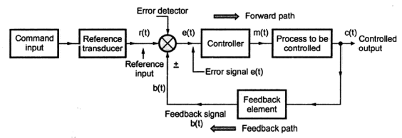
Closed Loop System
The reference signal (input) corresponds to desired output
Feedback samples the output and converts it to signal which is fed to error detector.
The signal obtained at error detected is the difference signal
Depending upon the error detector signal the controller is modified and the output is corrected
Control System Engineering , Don Bosco College of Engineering

Slide 20
Closed Loop System
When feedback sign is positive it is called as positive feedback system and if negative sign in the feedback then referred as negative feedback system
The error signal is then modified by the controller and decides the proportional manipulates signal for the process to be controlled
The manipulation is such that error signal approaches to zero. The signal then actuates the actual system and produces output. As the output is controlled hence called as controlled output.
Control System Engineering , Don Bosco College of Engineering

Slide 21
Closed Loop System
Advantages:
Disadvantages:
Accuracy is very high because controller modifies and manipulates the actuating signal such that error in the system will be zero
Senses environmental changes
Reduced effect of non-linearities and distortions
Bandwidth of such system is high
Complicated and time consuming from design point of view
Costlier
Presence of feedback tries to correct the error may cause oscillations without bound in the system. Hence stability problems may occur thus care should be taken while designing the system
Reduces gain of overall system
Control System Engineering , Don Bosco College of Engineering

Slide 22
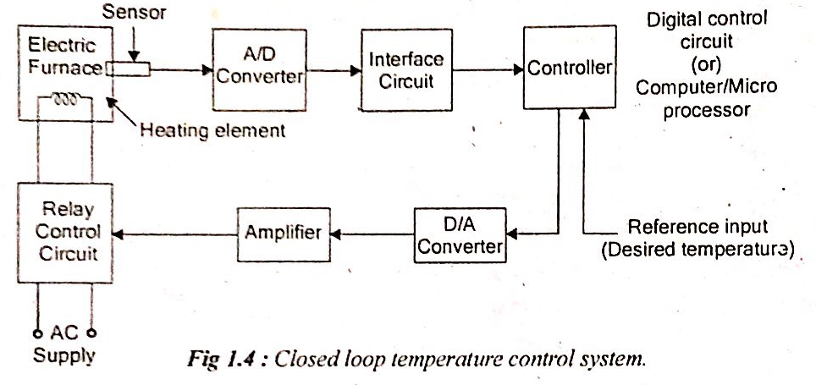
Examples of Closed Loop Control System
Example 1: Temperature Control System:
The output of the system is the desired temperature and it depends on the time during which supply to heater remains ON.
The switching ON and OFF of the relay is controlled by computer. The desired temperature input to the system is through a keyboard or signal corresponding to other ports etc.
The temperature is sensed and converted to digital form by A/D interface. The computer reads the actual temperature and compares with the desired temperature depending on which action is taken.
Control System Engineering , Don Bosco College of Engineering

Slide 23
Example 2: Traffic Control System
It can be open loop system as well
Can be made closed loop if time slots of the signals are decided based on intensity of traffic
Traffic is measured on all the sides and the information is fed to the computer
Based on traffic intensities the decision of traffic lights is taken
In such cases, the flow of vehicles much better than open loop system
Control System Engineering , Don Bosco College of Engineering

Slide 24
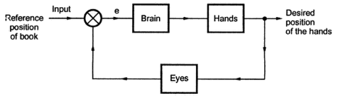
Example 3: Human Being (Closed Loop System)
Consider person wants to reach for a book on the table.
Position of the book is the reference position. Error signal is fed to the brain. Brain will signal to the hands to reach the book with help of the error signal
The process will continue till the person has got the book.
Control System Engineering , Don Bosco College of Engineering
Notes:
<number>

Slide 25
Question
Q. Studying Open Loop and Closed Loop system can you now differentiate between them?
Q. Can you give some more examples of open and closed loop system than ones already discussed?
Control System Engineering , Don Bosco College of Engineering

Slide 26
Open Loop v/s Closed Loop
Open Loop System
Closed Loop System
Any change in output has no effect on the input
Output measurement is not required for operation of system
Feedback element is absent
No error detection
Inaccurate and unreliable
Highly sensitive to disturbances
Highly sensitive to environmental changes
Small bandwidth
Simple to construct and cheap
Stable in nature
Affected by non-linearities
Change in output affects the input which is by use of feedback
Output measurement is required
Feedback element is present
Error detection is necessary
Highly accurate and reliable
Less sensitive to disturbances
Less sensitive to environmental changes
Bandwidth is large
Complicated to design and costly
Stability is major issue while designing
Reduced effects of non-linearities
Control System Engineering , Don Bosco College of Engineering

Slide 27


Control System Engineering , Don Bosco College of Engineering

Slide 28
The END
Control System Engineering , Don Bosco College of Engineering

